Slide 1

BANGALORE INSTITUTE OF TECHNOLOGY
K.R Road, V.V Pura, Bengaluru-04
DEPARTMENT OF ARTIFICIAL INTELLIGENCE & MACHINE LEARNING
“WINE QUALITY PREDICTION”
Presented by
GROUP ID: 07
VII Semester
Under the guidance of
Subha Meenakshi S
USN | NAME
1BI20AI057 | VYSHNAVI S.V.
1BI21AI403 | RAMYA K N

Slide 2
CONTENTS
Abstract
Introduction
Literature Review
Proposed System
System Architecture
System Requirements
Applications
Conclusion
References

Slide 3
ABSTRACT
The quality of a wine is important for the consumers as well as the wine industry. The traditional (expert) way of measuring wine quality is time-consuming. Nowadays, machine learning models are important tools to replace human tasks. In this case, there are several features to predict the wine quality but the entire features will not be relevant for better prediction. So, our thesis work is focusing on what wine features are important to get the promising result. The Wine Quality Prediction project aims to determine the quality of wines based on specific attributes using linear regression. By training a machine learning model on a dataset comprising various wine characteristics, the model can predict the quality rating of a given wine sample. The jupyter notebook code offers insights into the data preprocessing, model training, and evaluation stages.

Slide 4
INTRODUCTION
The quality of the wine is a very important part for the consumers as well as the manufacturing industries. Industries are increasing their sales using product quality certification. Nowadays, all over the world wine is a regularly used beverage and the industries are using the certification of product quality to increases their value in the market. Previously, testing of product quality will be done at the end of the production, this is time taking process and it requires a lot of resources such as the need for various human experts for the assessment of product quality which makes this process very expensive. Every human has their own opinion about the test, so identifying the quality of the wine based on humans experts it is a challenging task.

Slide 5
LITERATURE REVIEW
Sl. No. | Paper Title, Name of Journal, Year of Publication, Authors | Proposed Idea | Gap in Literature
1. | Title: "Modeling wine preferences by data mining from physicochemical properties." Author: Cortez, P., & Cerdeira, A., et al Published Year: 2019 Source: Decision Support Systems. | The primary objective of the study is to explore how data mining methods can be employed to model and predict wine preferences using physicochemical properties as input features. The researchers likely applied various data mining algorithms to analyze a dataset containing information on the physicochemical characteristics of wines. This could involve methods such as decision trees, clustering, or other machine learning approaches. The study specifically considers physicochemical properties of wines, which may include factors such as acidity, alcohol content, residual sugar, and other chemical attributes. These features are often crucial in understanding and predicting wine quality. | Withoutproper regularization techniques, the model might overfit the training data, capturing noise rather than genuine patterns. Conversely, if the model is too simple, it might underfit and not capture the complexity of wine preferences. The quality of predictions heavily relies on the quality of the dataset. If there are issues like missing or inaccurate data, it can impact the reliability of the model. Wine preferences are highly subjective and can vary widely among individuals. Models based on physicochemical properties alone may struggle to account for individual taste preferences and cultural differences.

Slide 6
LITERATURE REVIEW
Sl. No. | Paper Title, Name of Journal, Year of Publication, Authors | Proposed Idea | Gap in Literature
2. | Title: "Modeling and predicting the quality of red wine with artificial neural networks. “ Author: Romano, J., Kaisler, S., et al Published Year: 2018 Source: Expert Systems with Applications | The primary objective of the study is to explore the application of artificial neural networks for modeling and predicting the quality of red wine. ANNs are a type of machine learning algorithm inspired by the structure and function of the human brain. The study likely discusses the application of artificial neural networks, a type of computational model known for its ability to learn complex patterns from data. ANNs are particularly suitable for tasks involving non-linear relationships and can be used for regression or classification tasks. The focus of the study is on predicting the quality of red wine. Quality assessment in the context of wine often involves expert ratings or sensory evaluations, and the study likely explores how ANNs can be trained to make predictions based on input features related to wine characteristics. | The accuracy of any predictive model, including those based on artificial neural networks (ANNs), is heavily dependent on the quality & representativeness of the training data. If the dataset used is small, unbalanced, or not fully representative of the diversity of red wines, the model's predictions may lack reliability. The ability of the ANN model to generalize to different datasets or conditions might be a concern. If the study does not thoroughly explore the model's performance across diverse scenarios, its applicability could be limited.

Slide 7
PROPOSED SYSTEM
The proposed system aims to enhance the existing methods used for assessing wine quality by integrating data-driven approaches and leveraging advanced technologies.
Here are some components of the proposed system:
Data-Driven Analysis and Machine Learning
Sensor Technologies
IoT (Internet of Things) Applications:
Predictive Analytics
Automated Quality Control Systems

Slide 8
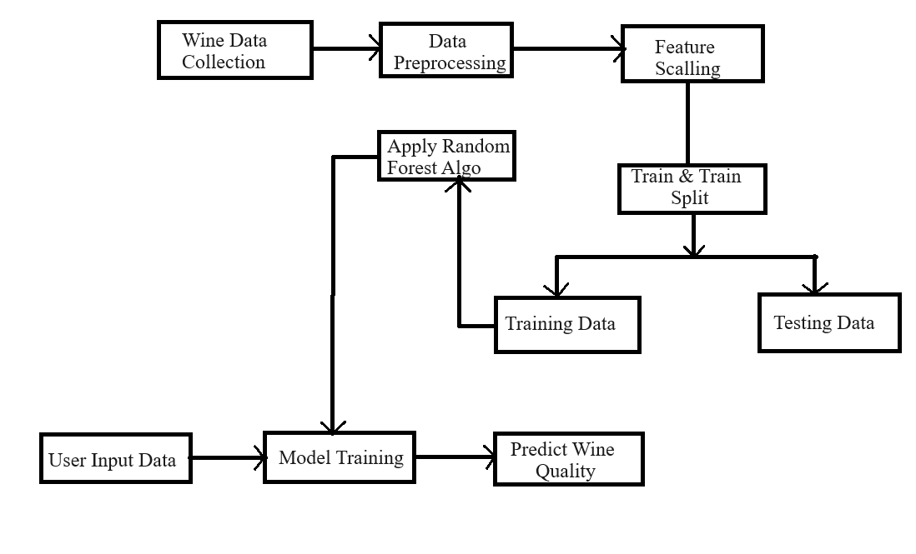
SYSTEM ARCHITECTURE

Slide 9
SYSTEM REQUIREMENTS
Software Requirements:
• Programming Language
• Machine Learning Libraries
• Data Analysis & Manipulation
• Data Visualization
• Jupyter Notebook

Slide 10
SYSTEM REQUIREMENTS
Hardware Requirements:
• CPU
• GPU
• RAM
• Storage
• Internet Connection

Slide 11
APPLICATIONS
Quality Assessment: Utilize machine learning to predict wine quality based on various features like acidity, alcohol content, and color intensity.
Customer Feedback Analysis: Analyze customer reviews and feedback to identify trends and areas for improvement and marketing strategies.
Process Optimization: Optimize winemaking processes by improving efficiency, and maintaining consistent quality.
Fraud Detection: Develop models to detect label misrepresentations by analyzing chemical compositions and patterns

Slide 12
CONCLUSION
This work demonstrated that various statistical analysis can be used to analyze the parameters in the existing dataset to determine the wine quality. Based on various analysis, the wine quality can be predicted prior to its production. Here the work shows that among various ML models, Regression Techniques performs best to predict the wine quality. This work shows an alternative approach that could be used to get the wine quality and, hence it can be a good starting point to screen the variables on which the wine quality depends.

Slide 13
REFERENCE
[1]https://www.tutorialspoint.com/machine_learning/wh at_is_machine_learning.htm
[2]https://towardsdatascience.com/exploratory-dataanalysis-8fc1cb20fd15
[3] https://en.wikipedia.org/wiki/Machine_learning
GITHUB LINK:
https://github.com/VyshnaviSV/wine-quality-prediction-

Slide 14
THANK YOU

